Slide 1
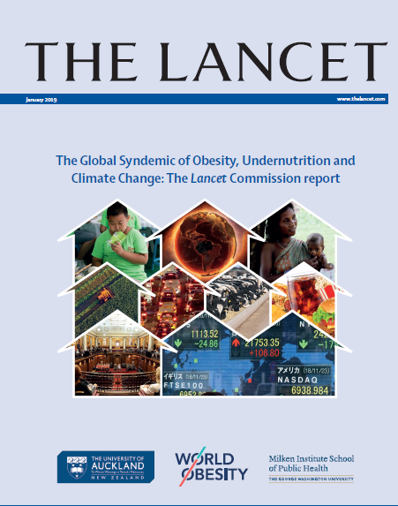
Lancet Commission on Obesity: Recommendations
www.thelancet.com/commissions/global-syndemic

Slide 2
Recommendations overview
Existing recommendations for nutrition and physical activity
Double- and triple-duty actions
Recommendations by actor:
  All actors
  Governments (national, city, municipal, business)
  Civil society, research
  Funders
  International agencies
Principles for recommendations
  Enhance existing recommendations
  Be systemic in nature
  Target the drivers
  Forge synergies
  Produce multiple benefits
  Address inequities

Slide 3
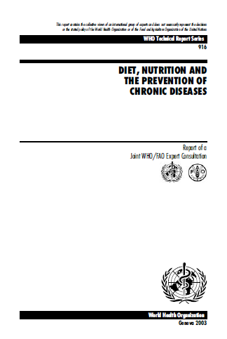

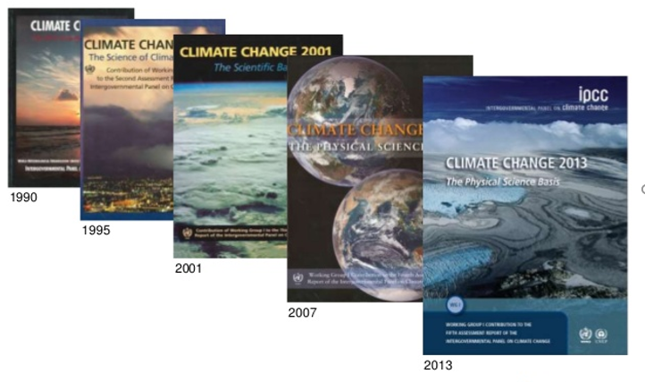
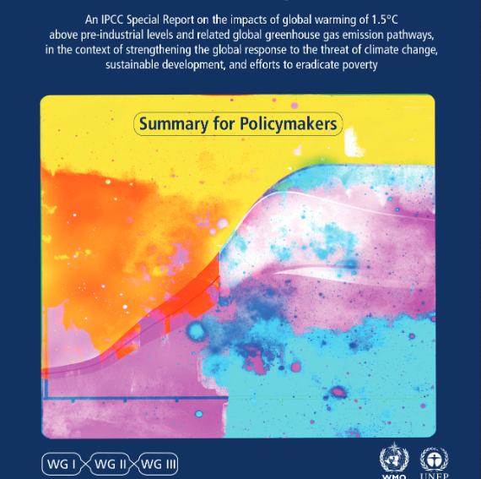

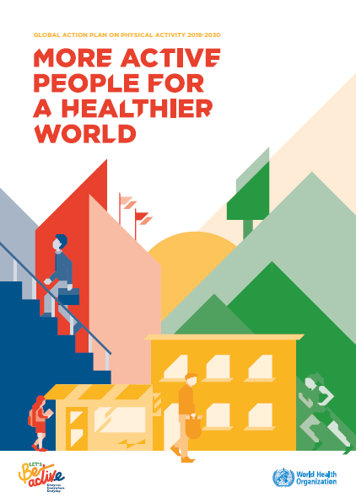
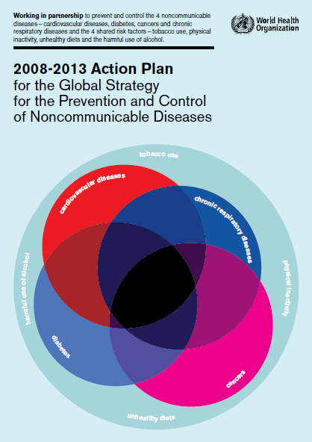


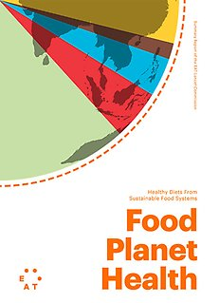
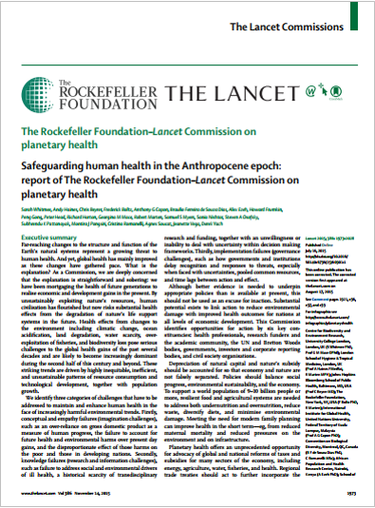
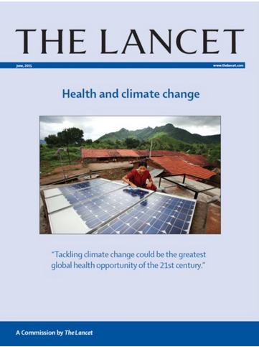
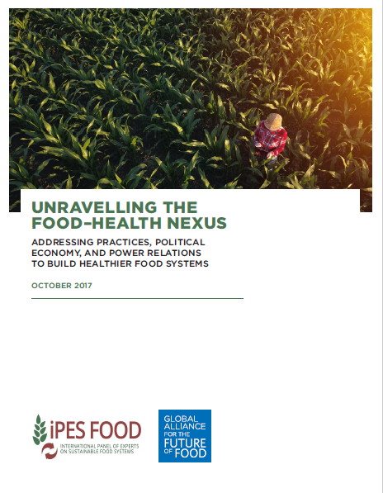

Slide 4
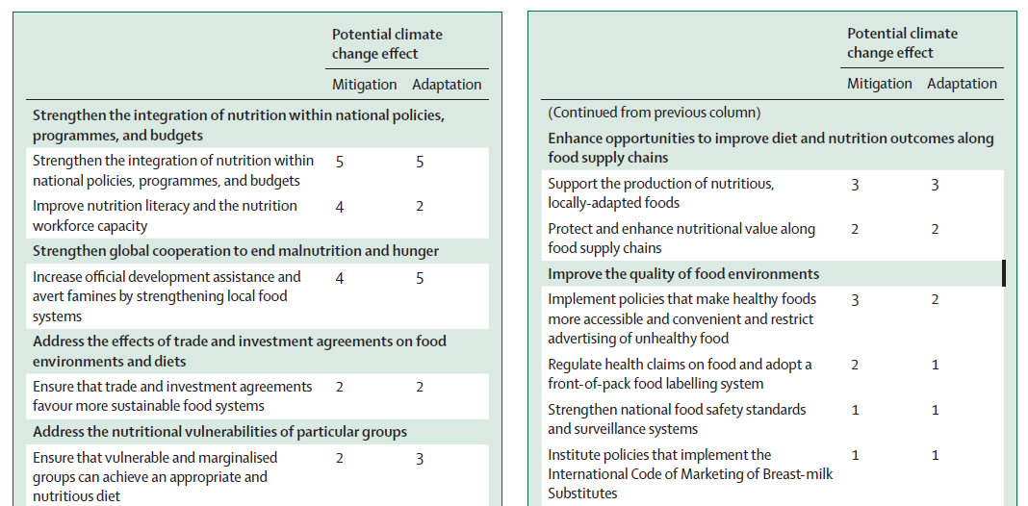
Recommendations for nutrition also have potential as climate change actions

Slide 5
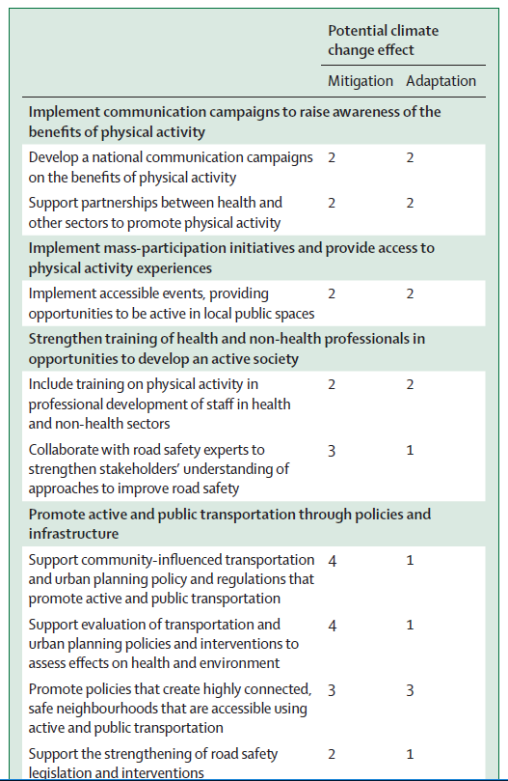
Recommendations for physical activity also have potential as climate change actions

Slide 6

Double- and triple-duty actions
Existing nutrition and PA recommendations benefit climate change but need to be purposively framed as such
Global Nutrition Report
  Double-duty actions address both undernutrition and obesity/NCDs
Double-duty or triple-duty actions influence 2 or 3 of The Global Syndemic pandemics

Slide 7
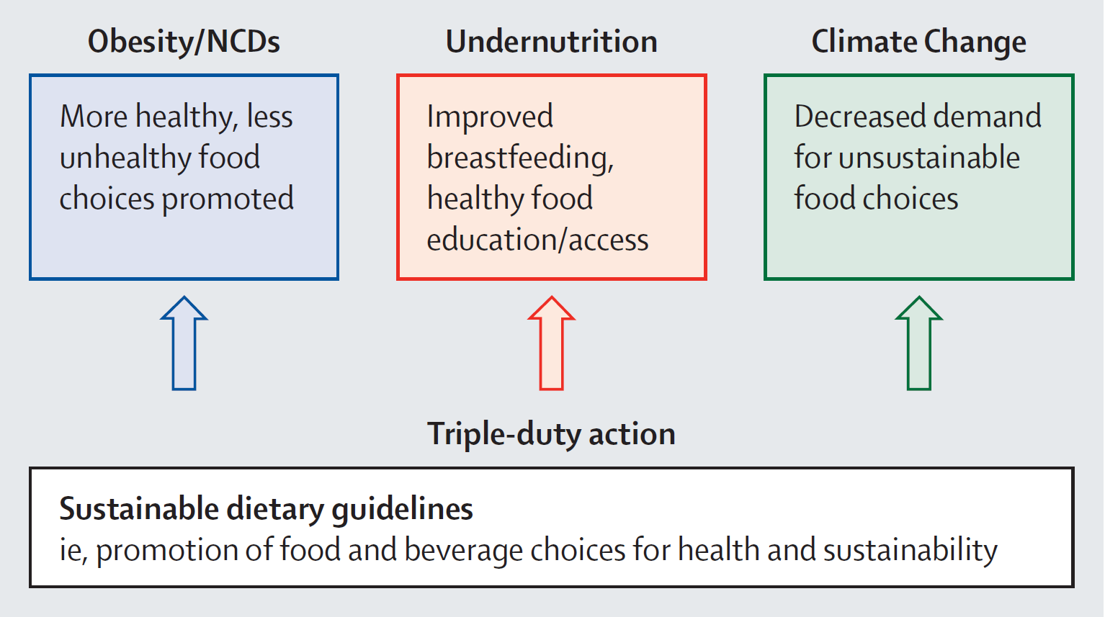

Slide 8
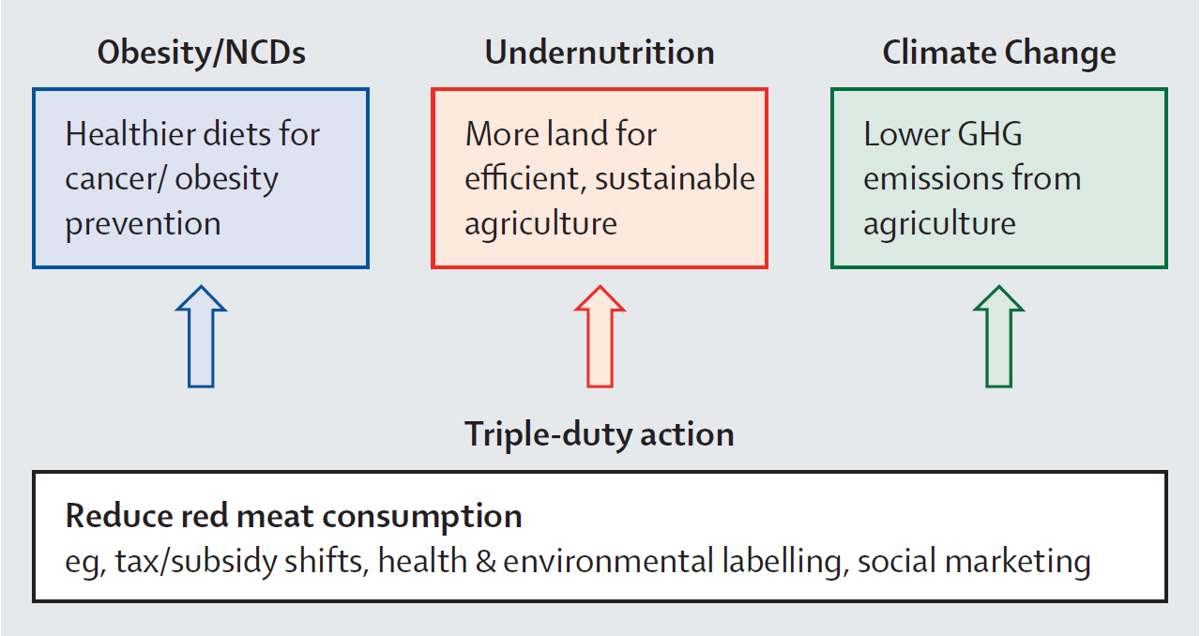

Slide 9
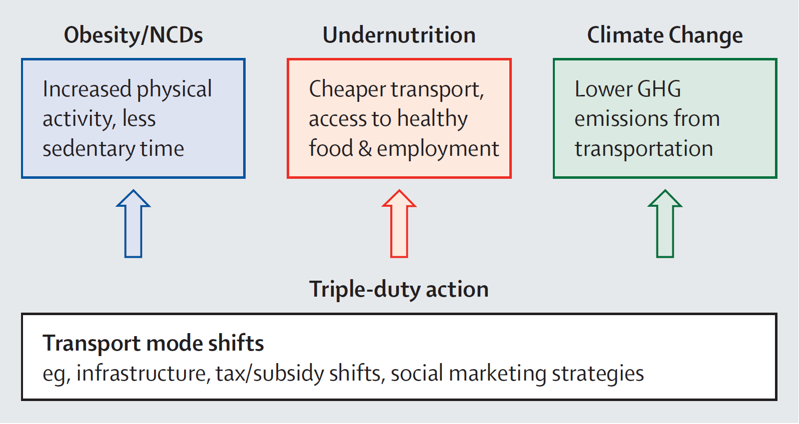

Slide 10
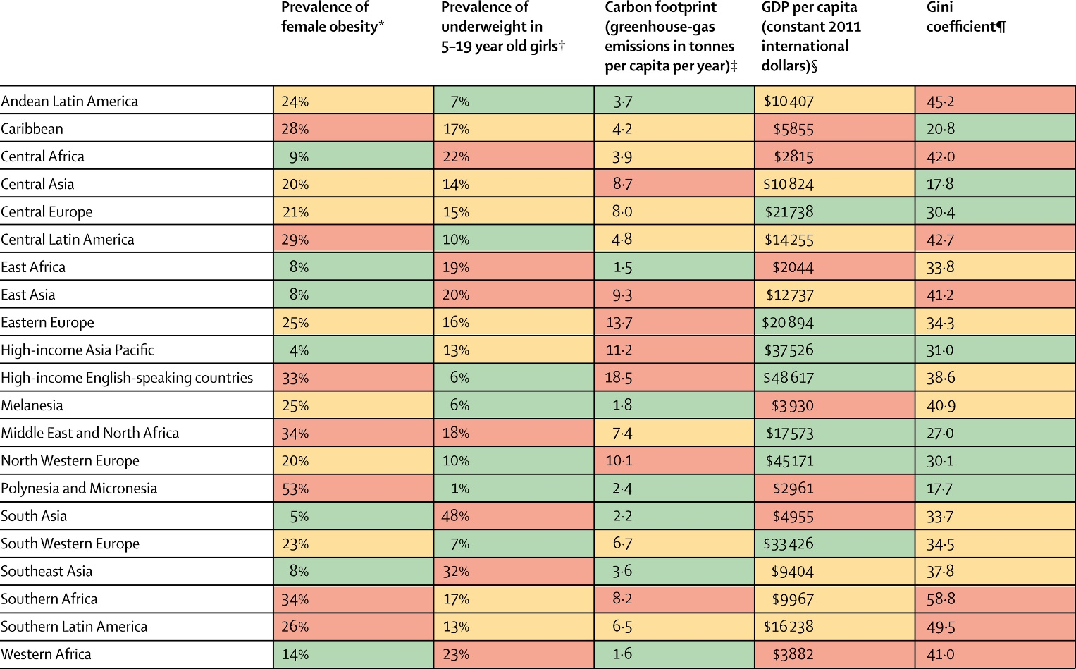
Context for action

Slide 11
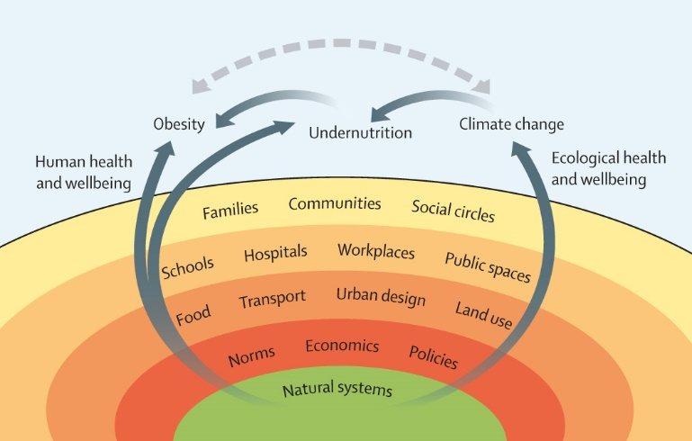
Actions for all actors
Think in Global Syndemic terms, understand the common causes and look for common solutions
Create collaborative platforms across existing silos to work on the double-duty and triple-duty actions for multiple benefits

Slide 12
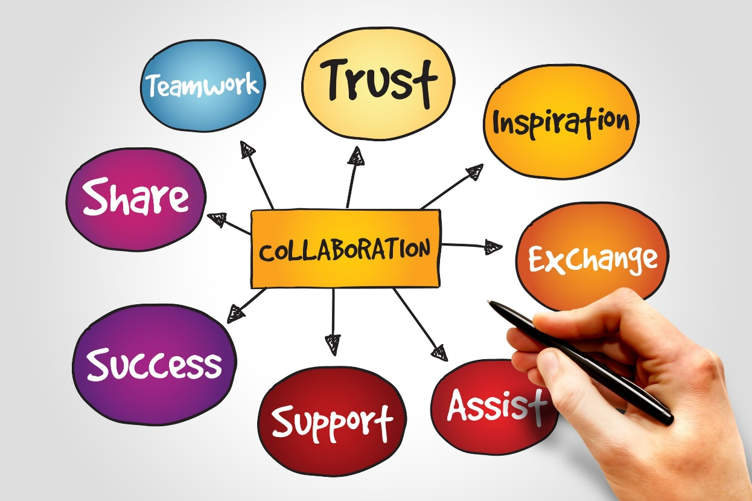
For all actors
Think in Global Syndemic terms, understand the common causes and look for common solutions
Create collaborative platforms across existing silos to work on the double-duty and triple-duty actions for multiple benefits

Slide 13
Actions for national governments
Reduce poverty and inequities
Fully implement human rights under the Right to Wellbeing
Change subsidies for harmful products (eg fossil fuels, foods that damage health and/or the environment) and reorient them towards sustainable agriculture and energy

Slide 14
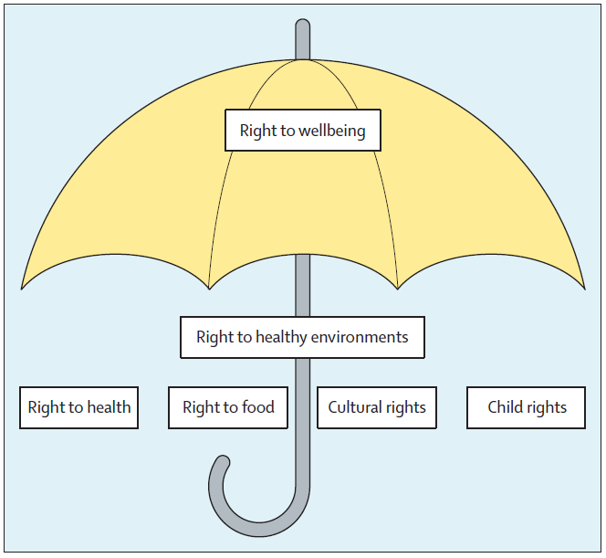
Actions for national governments
Reduce poverty and inequities
Fully implement human rights under the Right to Wellbeing
Change subsidies for harmful products (eg fossil fuels, foods that damage health and/or the environment) and reorient them towards sustainable agriculture and energy

Slide 15
Actions for national governments
Reduce poverty and inequities
Fully implement human rights under the Right to Wellbeing
Change subsidies for harmful products (eg fossil fuels, foods that damage health and/or the environment) and reorient them towards sustainable agriculture and energy

Slide 16
Actions for national governments (contd)
Reduce the influence of commercial vested interests in policy development and increase the roles for civil society
Re-orient business models for people and planet as well as profits (reduce externalities)
Provide clear information on the health and environmental effects of products to consumers
Accelerate SDG actions and accountability systems

Slide 17
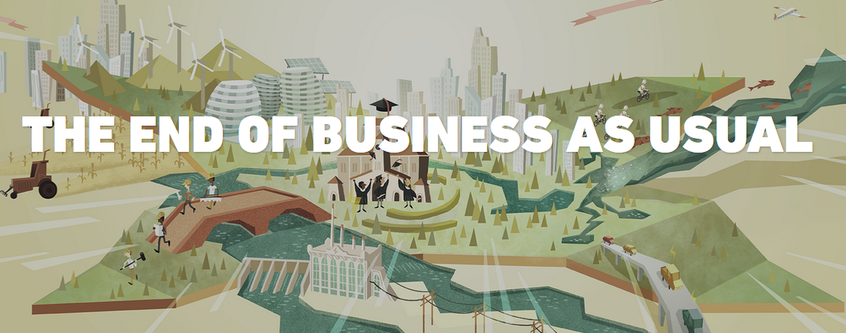
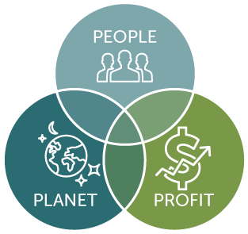
Actions for national governments (contd)
Reduce the influence of commercial vested interests in policy development and increase the roles for civil society
Re-orient business models for people and planet as well as profits (reduce externalities)
Provide clear information on the health and environmental effects of products to consumers
Accelerate SDG actions and accountability systems

Slide 18
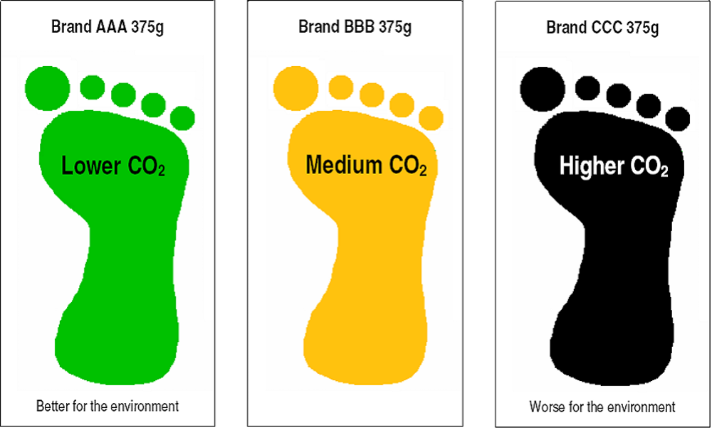
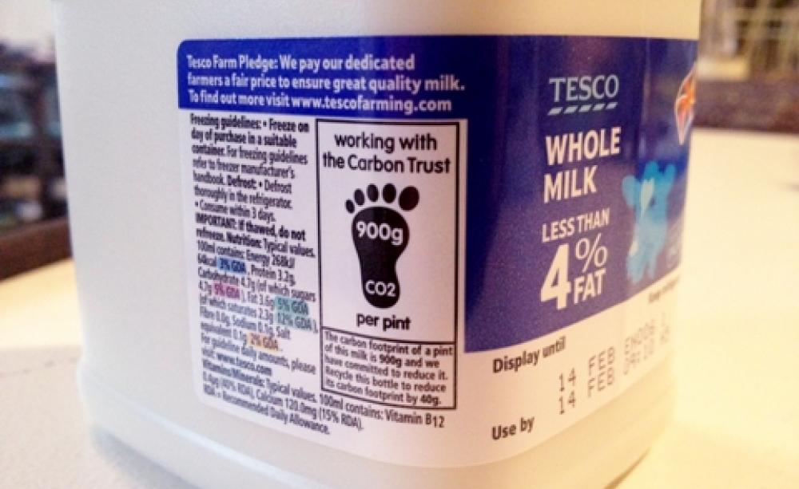
Actions for national governments (contd)
Reduce the influence of commercial vested interests in policy development and increase the roles for civil society
Re-orient business models for people and planet as well as profits (reduce externalities)
Provide clear information on the health and environmental effects of products to consumers
Accelerate SDG actions and accountability systems

Slide 19
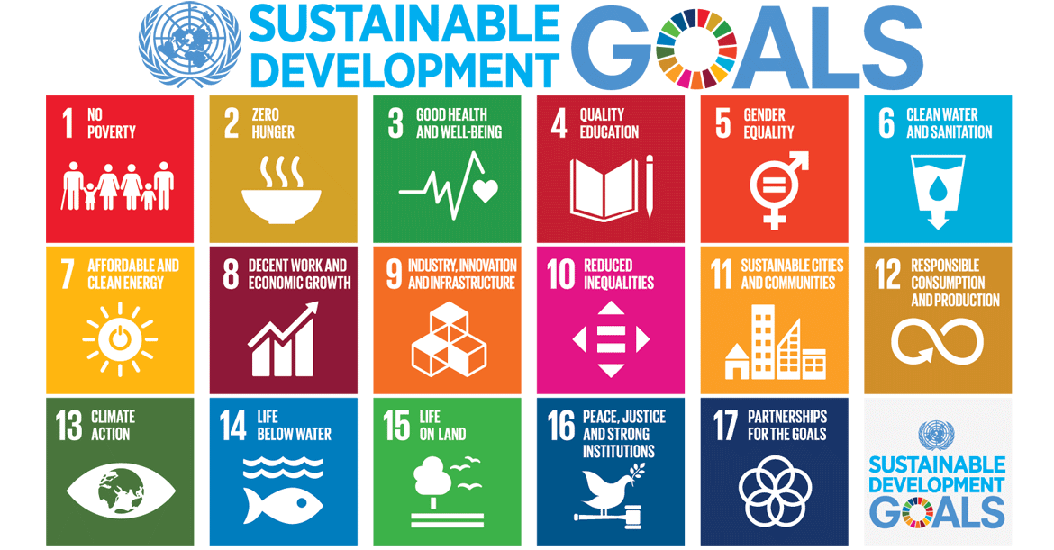
Actions for national governments (contd)
Reduce the influence of commercial vested interests in policy development and increase the roles for civil society
Re-orient business models for people and planet as well as profits (reduce externalities)
Provide clear information on the health and environmental effects of products to consumers
Accelerate SDG actions and accountability systems

Slide 20
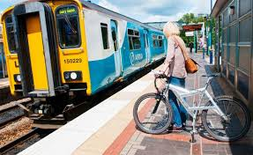
Actions for cities and municipalities
Invest in infrastructure for public transport and active transport
Build urban food systems for resilience, health, equity and environmental sustainability
Join international networks of cities to share resources and innovative strategies
Fund community coalitions to activate systemic change at the local level and advocate for supportive national polices

Slide 21

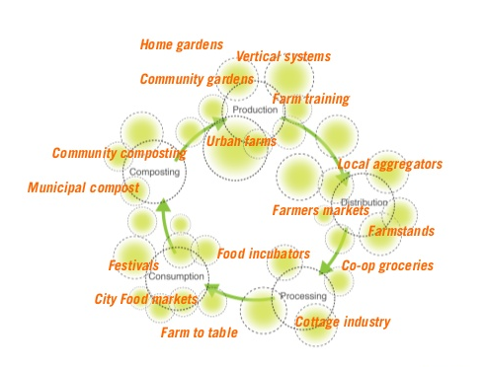
Actions for cities and municipalities
Invest in infrastructure for public transport and active transport
Build urban food systems for resilience, health, equity and environmental sustainability
Join international networks of cities to share resources and innovative strategies
Fund community coalitions to activate systemic change at the local level and advocate for supportive national polices

Slide 22
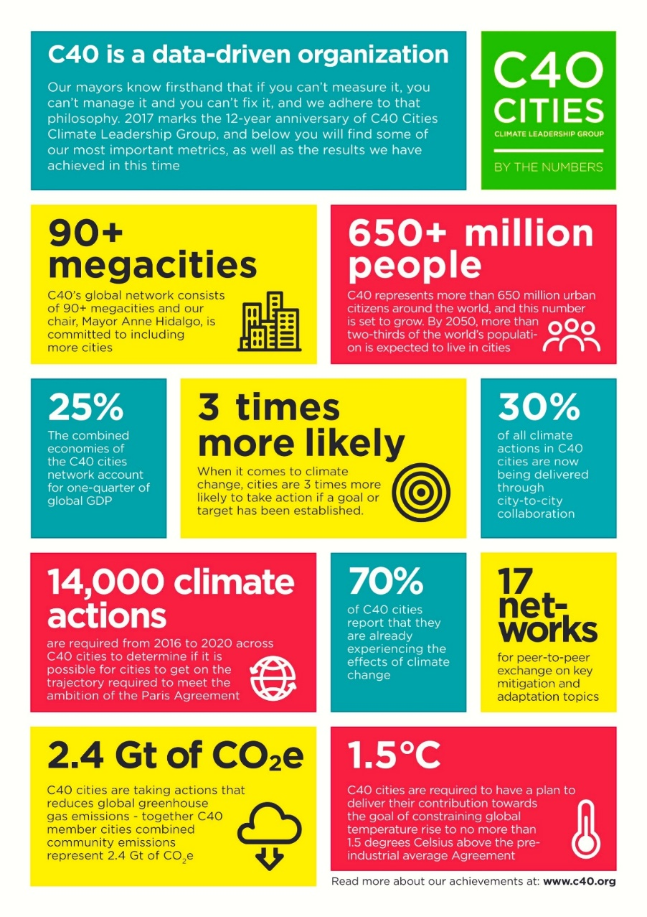
Actions for cities and municipalities
Invest in infrastructure for public transport and active transport
Build urban food systems for resilience, health, equity and environmental sustainability
Join international networks of cities to share resources and innovative strategies
Fund community coalitions to activate systemic change at the local level and advocate for supportive national polices

Slide 23
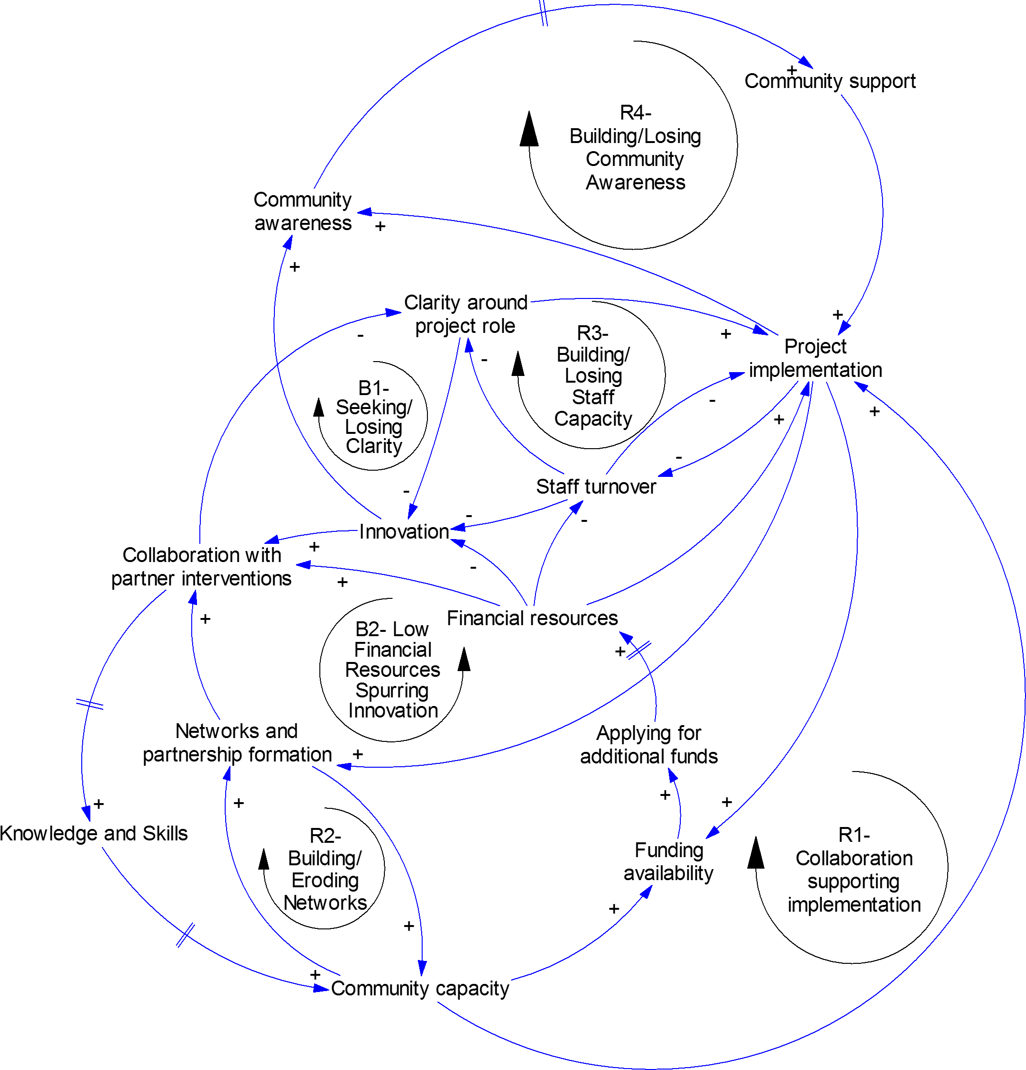
Actions for cities and municipalities
Invest in infrastructure for public transport and active transport
Build urban food systems for resilience, health, equity and environmental sustainability
Join international networks of cities to share resources and innovative strategies
Fund community coalitions to activate systemic change at the local level and advocate for supportive national polices

Slide 24

Actions for civil society
Build coalitions to increase the demand for policies to address aspects of The Global Syndemic
Monitor policy implementation for The Global Syndemic to increase independent accountability for action
Prioritise research for policy-relevant studies on the dynamics of The Global Syndemic and the impacts of double and triple duty actions

Slide 25
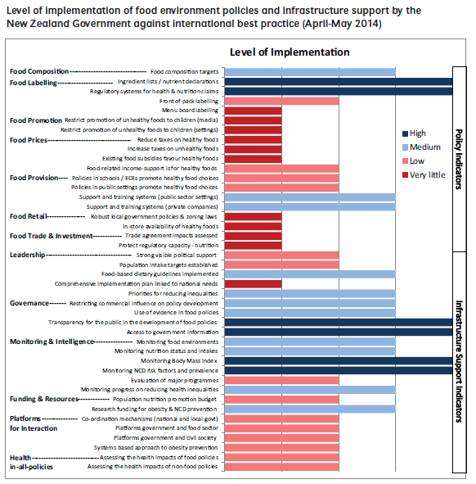
Actions for civil society
Build coalitions to increase the demand for policies to address aspects of The Global Syndemic
Monitor policy implementation for The Global Syndemic to increase independent accountability for action
Prioritise research for policy-relevant studies on the dynamics of The Global Syndemic and the impacts of double and triple duty actions

Slide 26
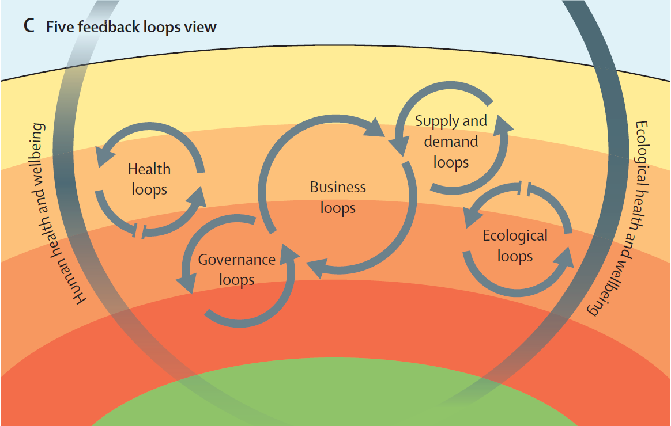
Actions for civil society
Build coalitions to increase the demand for policies to address aspects of The Global Syndemic
Monitor policy implementation for The Global Syndemic to increase independent accountability for action
Prioritise research for policy-relevant studies on the dynamics of The Global Syndemic and the impacts of double and triple duty actions

Slide 27
Actions for funders
Use development aid to improve governance, sustainable food systems, and land use to address The Global Syndemic
Develop a $1B global ‘Food Fund’ to support the efforts of civil society in 100 countries to increase demand for policy action
Establish a 7 Generations Fund to grow and apply indigenous and traditional knowledge to The Global Syndemic
2.2%
of health development aid for reducing the biggest killer in LMICs:
NCDs

Slide 28

Actions for funders
Use development aid to improve governance, sustainable food systems, and land use to address The Global Syndemic
Develop a $1B global ‘Food Fund’ to support the efforts of civil society in 100 countries to increase demand for policy action
Establish a 7 Generations Fund to grow and apply indigenous and traditional knowledge to The Global Syndemic

Slide 29
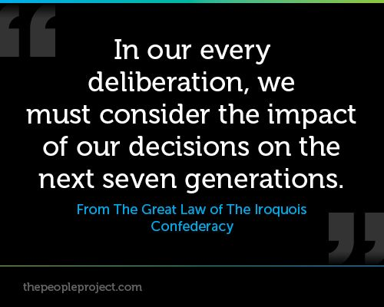
Actions for funders
Use development aid to improve governance, sustainable food systems, and land use to address The Global Syndemic
Develop a $1B global ‘Food Fund’ to support the efforts of civil society in 100 countries to increase demand for policy action
Establish a 7 Generations Fund to grow and apply indigenous and traditional knowledge to The Global Syndemic

Slide 30


Actions for international agencies
Establish a Framework Convention on Food Systems as the legal scaffolding for healthy, equitable, environmentally sustainable, and economically prosperous food systems
Monitor the implementation of policies recommended by UN agencies to address The Global Syndemic
Framework Convention on Food Systems

Slide 31




Actions for international agencies
Establish a Framework Convention on Food Systems as the legal scaffolding for healthy, equitable, environmentally sustainable, and economically prosperous food systems
Monitor the implementation of policies recommended by UN agencies to address The Global Syndemic

Slide 32
Summary
Many actions with double or triple benefits for The Global Syndemic
But progress to date is slow and patchy
Deep policies that affect the drivers:
  Are more important
  Are much more difficult to implement
  Have less direct evidence of impact
Examples of positive developments by all actors
Look for disruptors of business as usual: bold politicians, community movements, technology, legal levers, independent accountability

