Slide 1
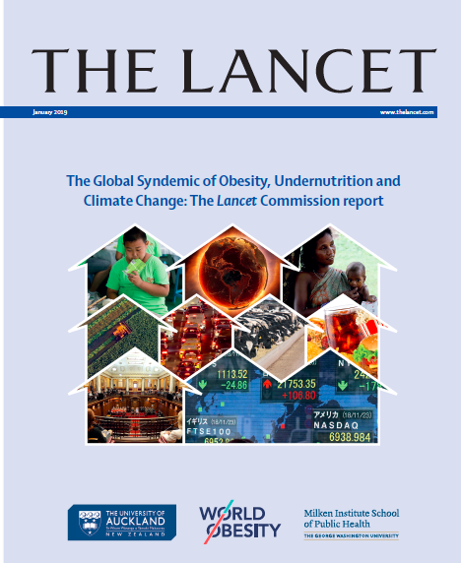
The Lancet Commission
Report: Introduction to
the Commission, The
Global Syndemic, and the
Systems that Drive It

Slide 2
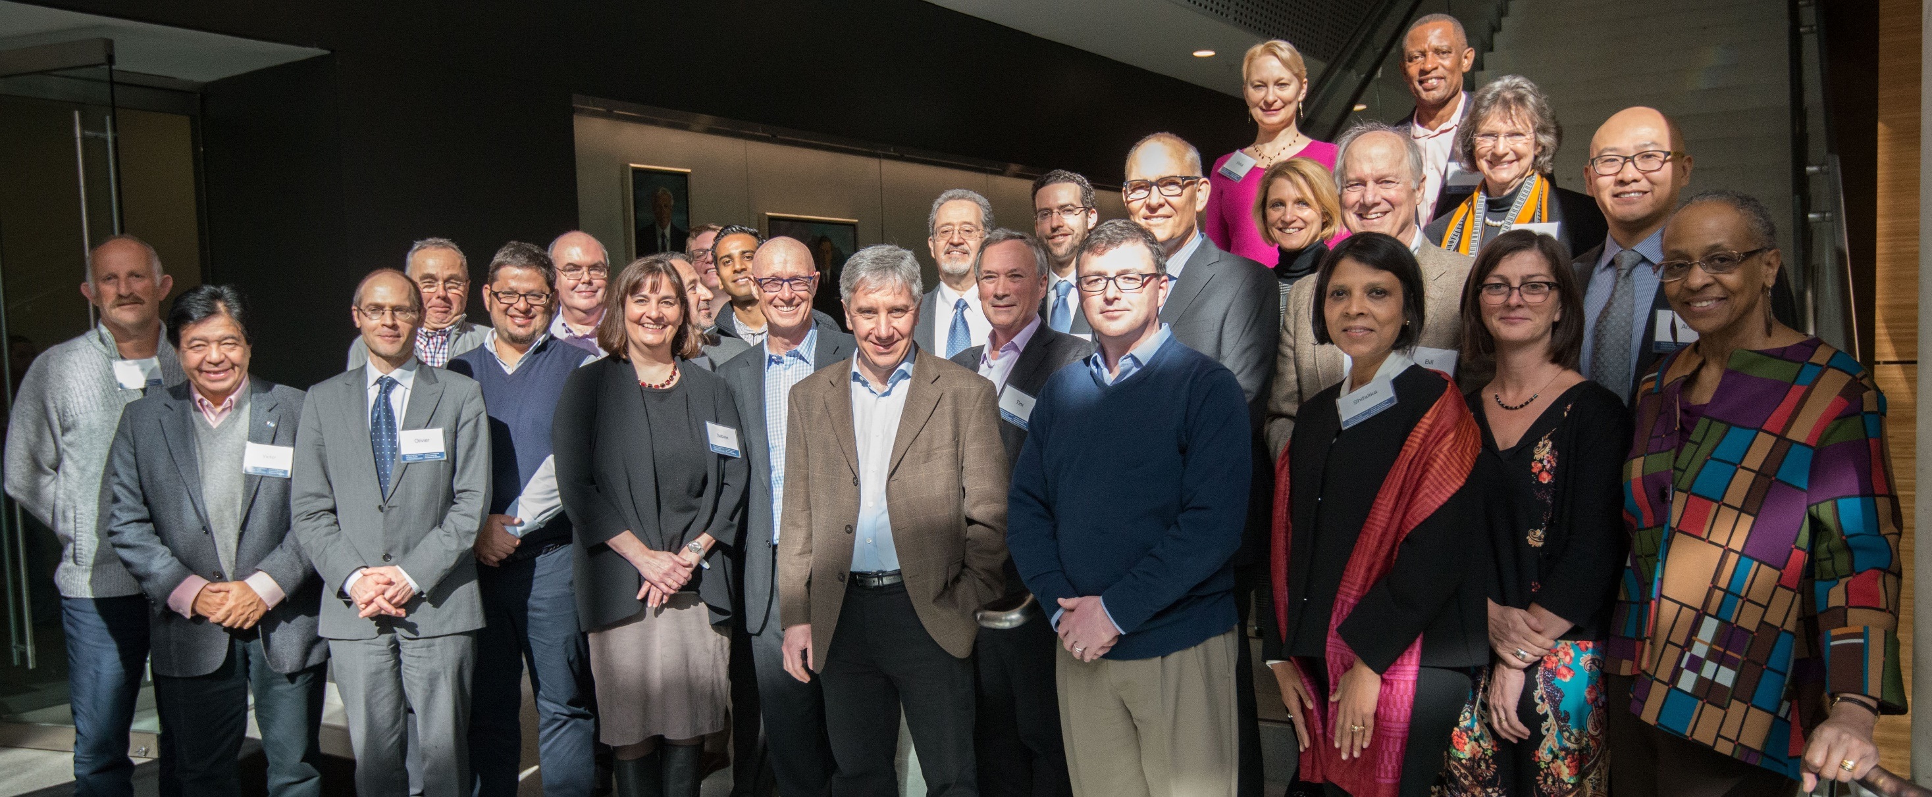
The Lancet Commission on Obesity
26 Commissioners from 14 countries, covering 25 disciplines and supported by 17 early career Commission Fellows

Slide 3
Aims and Processes of the Lancet Commission
Aims
Identify the systemic commonalities in drivers and solutions across obesity, undernutrition, and climate change
Describe double-duty or triple-duty policies and actions to address The Global Syndemic, and ways to strengthen accountability systems for their implementation
Processes
3 face-to-face meetings
2 group model building workshops
Literature reviews of existing systems models
9 international consultation workshops

Slide 4
The Obesity Context
Unabated rise in the prevalence of obesity globally
Policy inertia - industry resistance, lack of political will, and lack of public demand for change
Lack of urgency - stigma and bias?
Obesity is considered in isolation

Slide 5
Syndemic
Original definition: two or more diseases that interact in time and place, negatively affect each other and have common economic, societal, or enivironmental drivers
Example: Intravenous drug use, HIV and hepatitis C infections

Slide 6
The Global Syndemic
Definition: the interactions of the pandemics of obesity, undernutrition, and climate change in time and place, negatively affect each other, and have common economic, societal, or enivironmental drivers
Considered climate change as a pandemic
Driven by food, transport, urban design, and land use systems
Population rather than individual focused

Slide 7
Examples of Interactions
Obesity and stunting in the same children and same population
LBW and adult obesity
Car use, inactivity, and GHG emissions
Cattle production, GHG emissions, meat consumption and colon cancer, CVD, and obesity
GHGs, climate change, catastrophic weather events, and reduced agricultural production and food nutrients, especially in marginal areas, leading to hunger and undernutrition

Slide 8
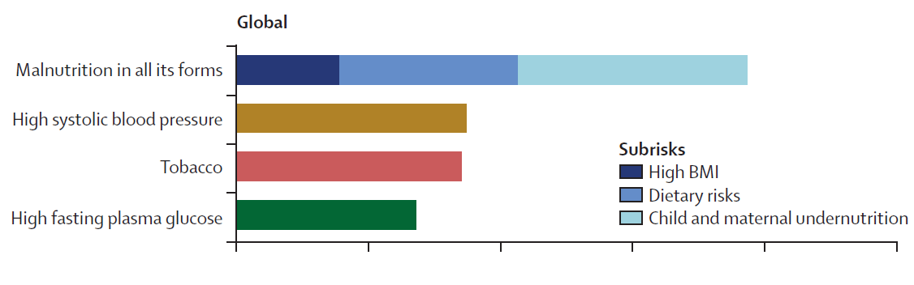
Components of Malnutrition in All Its Forms
High Body Mass Index (BMI) – risks for non-communicable diseases (NCDs)
Dietary Risks – risks for NCDs (eg low in grains, F&V, nuts / high in sodium, trans fats)
Child & maternal undernutrition – risks for nutrient deficiencies, and infectious diseases
DALYs
Disability-Adjusted Life years lost
5% 10% 15% 20% 25%

Slide 9
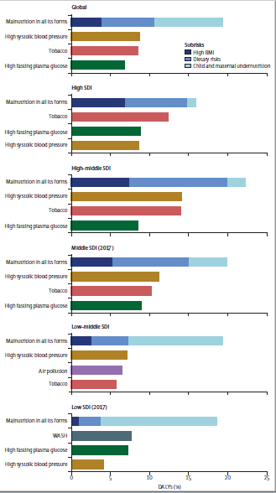
At every stage of development, malnutrition in all its forms is the highest risk for ill-health and premature death
Global
High
High-middle
Middle
Low-middle
Low
Type of malnutrition differs by stage of development
A. Ashfin, personal communication

Slide 10
Governance Systems Outcomes
LCO Framework
The Global Syndemic
>
Obesity
>
>
>
(DOHaD)
Power: Policies Economics Social Norms
Food Transport Land Use Urban Design
>
Undernutrition
Social Determinants
Environments
>
(Food
Supply)
>
>
Climate Change

Slide 11
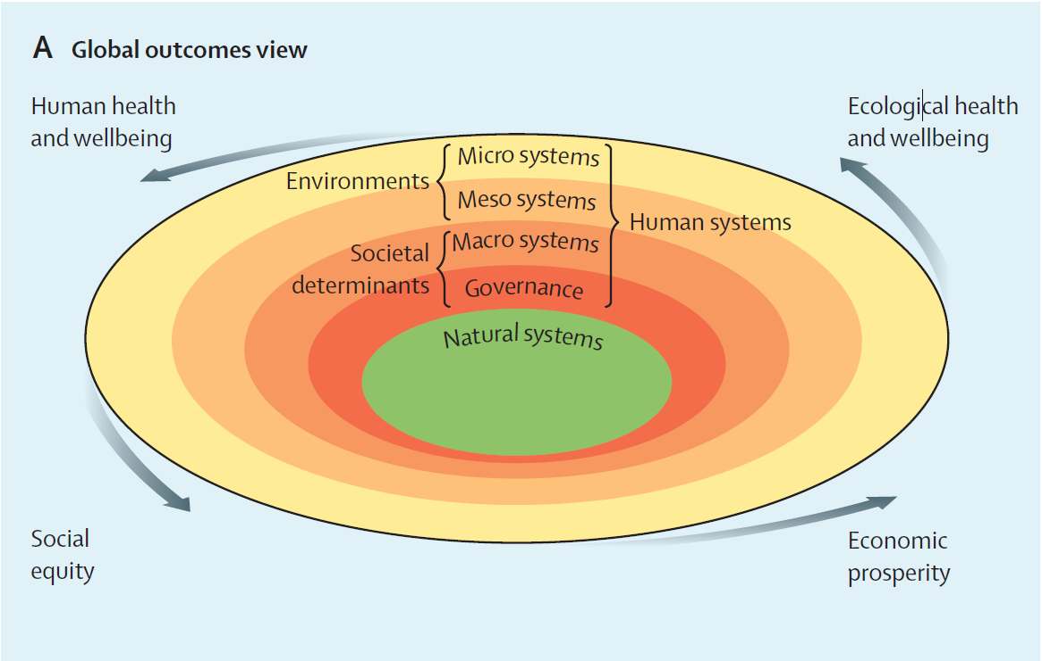

Slide 12
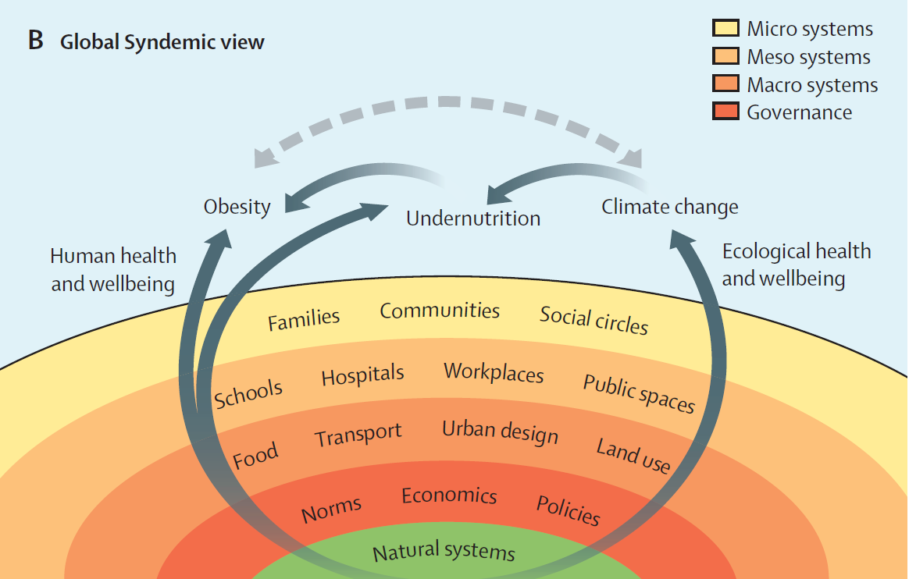

Slide 13
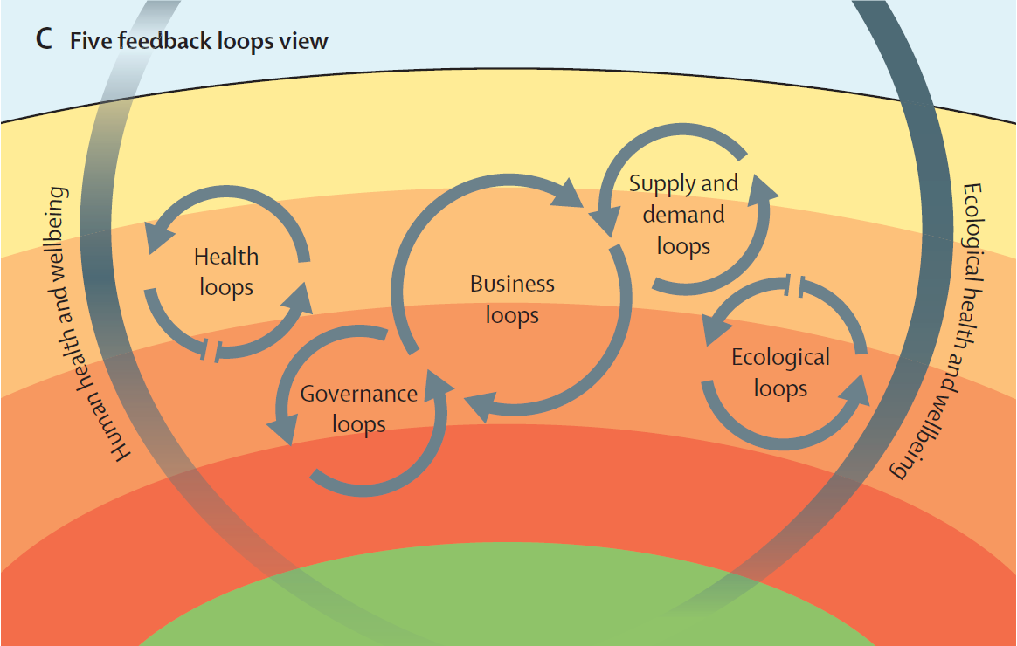

Slide 14
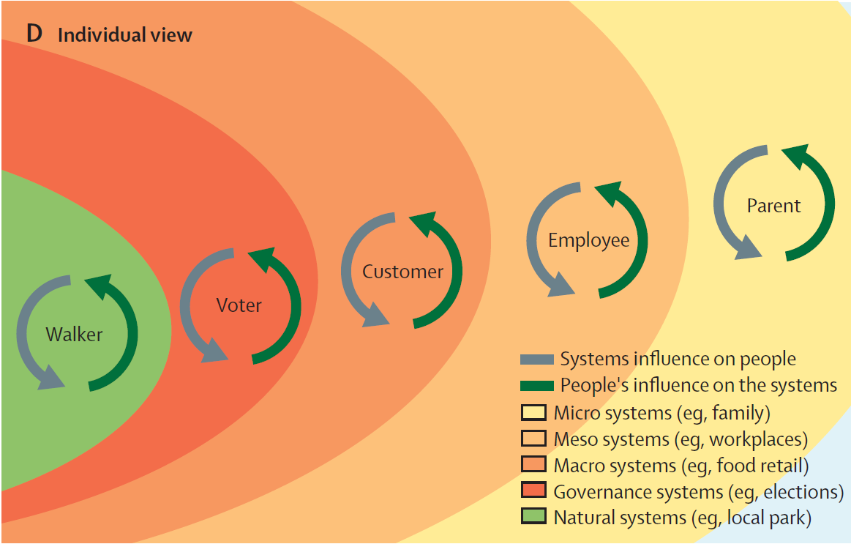

Slide 15
Summary
The Global Syndemic
  Common drivers for obesity, undernutrition, climate change
  Common solutions – double and triple duty actions
Systems underpin the syndemic and its outcomes
    Ecological health, Human health, Social equity, Economic prosperity
Five feedback loops
    Governance, Business, Supply/Demand, Health, Ecological
Individuals
  Affected by the systems and agents within the systems

