Slide 1
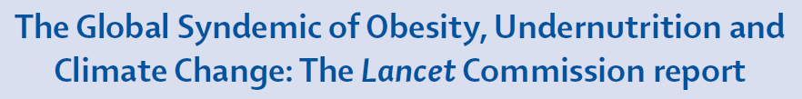
www.thelancet.com/commissions/global-syndemic
From policy inertia to implementation
A focus on the ‘how’
Sharon Friel
School of Regulation and Global Governance (RegNet)
Australian National University
Sharon.friel@anu.edu.au
@SharonFrielOz
Notes:
Moving from policy inertia to policy implementation
Recap policy inertia
Governance challenges (creating policy coherence, generating sustained govt commitment, mobilising resources, addressing power asymmetries)
Strengthening governments (Framework Convention, Right to Wellbeing, shaping business models for 21st century)
Reducing commercial opposition (equivalent clause to 5.3 in FCFS, shifting from CSR to corporate accountability for health, social and env outcomes)
Mobilising civil society ($1B fund to apply the ‘Mexico approach’ to 100 countries, 7 Generations Fund to build indigenous/traditional knowledge for living within env limits)

Slide 2
The underlying drivers remain unabated.
Policy Inertia - policy action has been very slow and patchy despite 20 years of headline stories in the media and stacks of reports from WHO and other authoritative bodies.
Policy silos - obesity has been considered in isolation from other major global challenges, such as undernutrition and climate change, which are facing the exact same policy inertia

Slide 3
Reasons for policy inertia…
Industry opposition to governments implementing WHO-recommended policies
  Transnational sugary drinks companies have been the most prominent sector to undermine government attempts to tackle obesity

Slide 4
Reasons for policy inertia…
2. Governments reluctance to implement regulatory policies
  Pervasive paradigms that education and market solutions will work

Slide 5
Command and control
Meta-regulation
Co-regulation
Self-regulation
Market mechanisms
Voluntarism
Ayres & Braithwaite 1992 “Responsive Regulation: Transcending the Deregulation Debate” OUP
Notes:
Principles of responsive regulation
Regulation is not just enforcement - it is about ‘influencing the flow of events’ (not just enforcing compliance with rules)
Enforcement capacity – ability to back threats
Involve multiple actors - state and non-state
Be responsive - build on structures, cultures and strengths
Use multiple mechanisms –supports as well as sanctions
Build networked governance – involve many actors
Minimise regulatory burden –coordinate actors, harmonise mechanisms.
Regulatory pyramid offers a framework for considering array of regulatory strategies

Slide 6
Reasons for policy inertia…
2. Governments reluctance to implement regulatory policies
  Pervasive paradigms that education and market solutions will work
  ‘Regulatory Chill’ – fear of the battle ahead if a policy is proposed
  Corrupt governments, susceptibility to industry lobbying, competing agendas

Slide 7
Reasons for policy inertia…
3. Lack of demand for government action from civil society and the public
  There is usually majority public support for policies but it is a quiet support

Slide 8
Activating the policy asks…

Slide 9
Notes:
So, how do we go from all of that inertia to action on these policy asks…
How can public policy and market practices that contribute to the Global Syndemic be reimagined for the public good, and how the agency and interests of socially-oriented – and usually structurally weaker – actors can be harnessed in ways that recalibrate these practices to protect the health of the planet and societies’ disadvantaged groups

Slide 10
Governance for the public good
Government
Industry
Civil Society

Slide 11
A courageous public sector
Driving coherent action
Generating and sustaining commitment
Mobilising capacities and resources
Addressing power asymmetries in food systems

Slide 12
It can be done:
Doha Declaration on TRIPS and Public Health 2001
Watertight evidence
Persuasive framing
Circles of consensus: collective vision among developing countries
Broad-based coalition of states integrated with NGO networks
Notes:
Provided safeguards and allowed flexibility for countries to bypass patents to protect public health (e.g. in circumstances of emergency)
Rights to use these safeguards/flexibilities reaffirmed in the Doha Declaration in 2001

Slide 13
Using global treaties for the public good
Framework Convention on Tobacco Control
International Health Regulations
International human rights treaties
Environmental agreements (UNFCCC)
Trade treaties
Framework Convention on Food systems
Notes:
HARD POWER
International human rights treaties, trade treaties (notably those negotiated through the World Trade Organisation), environmental agreements (such as those affecting climate change or biodiversity), the Framework Convention on Tobacco Control and the International Health Regulations are examples of global legal and regulatory instruments which may be useful in the pursuit of sustainable development. Some legally binding and some non-binding.
The United Nations Framework Convention on Climate Change (UNFCCC) is an international environmental treaty (currently the only international climate policy venue with broad legitimacy, due in part to its virtually universal membership) negotiated at the Earth Summit in Rio de Janeiro 1992. The objective of the treaty is to "stabilize greenhouse gas concentrations in the atmosphere at a level that would prevent dangerous anthropogenic interference with the climate system". The treaty itself set no binding limits on greenhouse gas emissions for individual countries and contains no enforcement mechanisms. In that sense, the treaty is considered legally non-binding. Instead, the treaty provides a framework for negotiating specific international treaties (called "protocols") that may set binding limits on greenhouse gases. It entered into force on 21 March 1994. As of March 2014, UNFCCC has 196 parties. The parties to the convention have met annually from 1995 in Conferences of the Parties (COP) to assess progress in dealing with climate change. In 1997, the Kyoto Protocol was concluded and established legally binding obligations for developed countries to reduce their greenhouse gas emissions. The 2010 Cancún agreements state that future global warming should be limited to below 2.0 °C (3.6 °F) relative to the pre-industrial level.^{[5]} The 20th COP took place in Peru in 2014.^{[6]}
A number of conditions were important to the successful development of the FCTC. Collin and colleagues described how coalitions of WHO member states, who are the core constituency of the FCTC – quickly formed. For example, at the 1999 World Health Assembly a record fifty member states took the floor to commit political and economic support for the proposed two-step process leading to negotiation of the FCTC (including the establishment of an Intergovernmental Negotiating Body (INB). The Johannesburg Declaration on the FCTC was adopted by twenty-one countries of the African Region in WHO in March 2001. This common front was widely perceived as a commitment to progressive control measures, in combination with calls for assistance in agricultural diversification (Collin et al. 2002). Drawing on Shiffman, who notes that coalitions are more likely to advance their issue into policy negotiations when they frame the problem and solutions in ways that resonate with the beliefs and ideologies of political decision-makers (Shiffman 2009) – an important frame that was used consistently was tobacco as an ‘emergency’ public health issue requiring firmer action.
NGOs were important actors in the successful negotiations of the FCTC, engaging in formal and informal ways. WHO held public hearings as a way to encourage the participation of non-state actors and provide a mechanism for interested groups to register their views before the start of negotiations. Over 500 written submissions were received, and 144 organisations provided testimony during the two-day hearings, including well-established public health non-government organizations, activist networks, academics, as well as tobacco companies. Informally, NGOs utilized strategies to educate, mobilize, and engage supporters. They organised seminars and preparing briefings for government delegates on technical aspects of the proposed treaty. NGOs were effective lobbyists, holding policy discussions with governments, letter-writing to delegates and heads of state, advocacy campaigns, press conferences before, during and after the negotiation meetings, and the publication of reports into tobacco industry practices. The power of NGOs and health activists increased when the Framework Convention Alliance was formed. Comprising over sixty NGOs, the Alliance was created to improve communication between those groups already engaged in the FCTC process and to help reach smaller NGOs in developing countries.

Slide 14
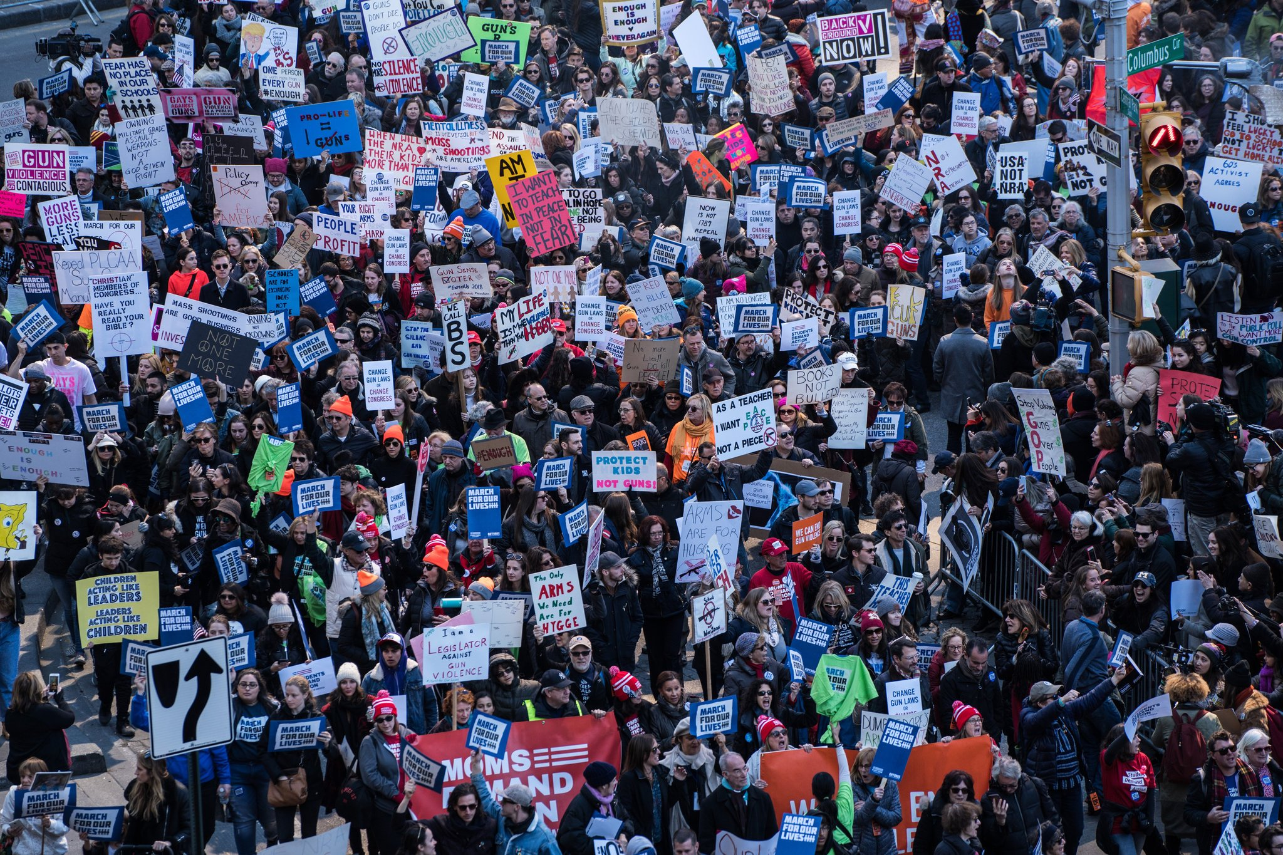
Networks of hope
Networks of hope
Notes:
Instrumental: Because of their economic importance and through shared participation in elite networks, business leaders tend to have good access to and influence with political decision-makers. Capable of coordinating efforts globally.
Structural: Globalization enhances the power of TNCs because of an increasing ability to make transnational investment decisions, states must increasingly compete with one another to attract and retain capital.
Discursive Power
Power as a function of norms and ideas, the importance of shaping the narrative and its symbolism
Discursive power shapes perceptions and identities
The “third face of power’ (Lukes) – control over agendas and meaning-construction even in the absence of conflict
While the discursive power of industry is considerable, social movements can also invoke discursive power
The industry has not succeeded in keeping climate change off the political agenda
However it has sown sufficient disinformation and doubt as to slow or stall effective action
Whether the discursive power of the divestment movement and others will be sufficient to overcome that of the fossil fuel industry is an open question
NGOs are trusted, business isn’t (but cf the influence of political elites)

Slide 15
SSB in Mexico
Challenge: Overcoming the power of vested interests.
Mobilized civil society networks:
Healthy Food Consortium: a cohesive civil society network effectively campaigned for the SSB tax.
Raise awareness, give voice, generate demand, hold government and other stakeholders accountable.
Collective vision, multi-pronged communications campaign, direct engagement with policy-makers, policy windows.
Notes:
Following the introduction of Mexico’s 1-peso-per-liter sugary beverage tax in 2013, sales fell by 5.5% in the first year and 9.7% in the second year (compared to pre-tax sales figures), with the largest declines among low-socio-economic populations.
Networked civil societies, including non-government organizations and more informal social movements bound by a common interest, play important roles in governance. They raise awareness, give voice to politically marginalised population groups, and often act as a powerful social accountability mechanisms (e.g. by monitoring and ‘naming and shaming’ governments and industry when failing to meet commitments). Crucially, the effectiveness of civil society is enhanced in the context of governance arrangements that incorporate transparent and inclusive decision-making processes.
Mexico provides an example of networked governance, where collective civil society action resulted in the introduction of a national tax on sugar sweetened beverages. The Alliance for Healthy Food, a consortium of civil associations, social organizations and professionals concerned about the epidemic of overweight and obesity in Mexico, played a key role in mobilizing government commitment to implement a tax on sugar sweetened beverages in 2014. The Alliance launched a multi-pronged communications campaign to raise public awareness of the risks of sugary soft drinks, engaged directly with congress members, and entered into dialogue with the Ministry of Finance. This coincided with an opening policy window as Mexico’s health minister, and a newly elected President and legislature supported the tax within a broader fiscal reform agenda [Ref] .
Donaldson, E (2017) Advocating for sugar-sweetened beverage taxation: a case study of Mexico. Johns Hopkins Bloomberg School of Public Health. Baltimore.
encouragingly, coalition building and articulation of a shared goal has started among nutrition NGOs and some governments in relation to restrictions on marketing of food to children; nutrition labelling, and fiscal and pricing policy. For example, in Mexico an active civil society network, worked together with a receptive government and policy advocate in the health minister to generate wide support for the successful introduction of a national level soda tax (a tax on sugar-sweetened beverages). While this is still a market-based solution, and thus an incremental regulatory fix, to the extent that it reduces consumption of harmful products it is a step in the right direction (Moscetti and Taylor 2015). In this instance, funding provided by Bloomberg Philanthropies enabled the civil society networks to pursue a powerfully framed pro-tax media campaign, highlighting the potential role for global nutrition actors at the local level (Batis et al. 2016). The same networked strategy has been successful in passing soda taxes in seven local jurisdictions in the US (Falbe et al. 2016, Paarlberg et al. 2017).
While these soda tax successes may seem like a drop in the ocean, they are a start. The global nutrition and health community can build on these and learn salient lessons from other policy areas

Slide 16
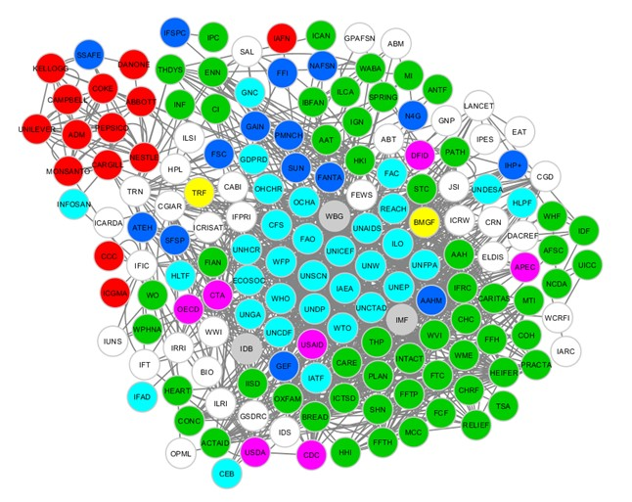
Enormous potential: global nutrition actors
Nodal governance
Light blue = UN system; Green = civil society / NGOs; Pink = National governments; Grey = financial institutions; Yellow = Philanthropic organizations; Red = Private industry; Dark blue = Public-private partnerships; White = Research institutes, networks, professional organizations.
Notes:
Thinking about this in a nodal way:
A way of thinking (mentalities) about the matters that the node has emerged to govern; UNSCN – UN policy coherence:
A set of methods (technologies) for exerting influence over the course of events at issue;
Resources to support the operation of the node and the exertion of influence; and
A structure that enables the directed mobilization of resources, mentalities and technologies over time (institutions)

Slide 17


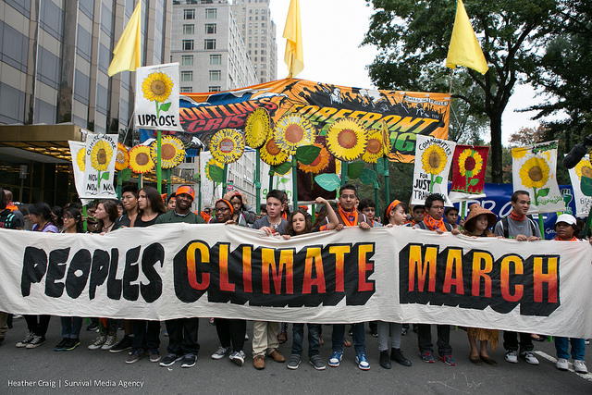
Networked civil society
Rising political consciousness
Collective vision
Holding to account

Slide 18
What role for industry?
Not at the policy development table
Rules of engagement / COI
Enlightened business models
Notes:
HARD POWER
International human rights treaties, trade treaties (notably those negotiated through the World Trade Organisation), environmental agreements (such as those affecting climate change or biodiversity), the Framework Convention on Tobacco Control and the International Health Regulations are examples of global legal and regulatory instruments which may be useful in the pursuit of sustainable development. Some legally binding and some non-binding.
The United Nations Framework Convention on Climate Change (UNFCCC) is an international environmental treaty (currently the only international climate policy venue with broad legitimacy, due in part to its virtually universal membership) negotiated at the Earth Summit in Rio de Janeiro 1992. The objective of the treaty is to "stabilize greenhouse gas concentrations in the atmosphere at a level that would prevent dangerous anthropogenic interference with the climate system". The treaty itself set no binding limits on greenhouse gas emissions for individual countries and contains no enforcement mechanisms. In that sense, the treaty is considered legally non-binding. Instead, the treaty provides a framework for negotiating specific international treaties (called "protocols") that may set binding limits on greenhouse gases. It entered into force on 21 March 1994. As of March 2014, UNFCCC has 196 parties. The parties to the convention have met annually from 1995 in Conferences of the Parties (COP) to assess progress in dealing with climate change. In 1997, the Kyoto Protocol was concluded and established legally binding obligations for developed countries to reduce their greenhouse gas emissions. The 2010 Cancún agreements state that future global warming should be limited to below 2.0 °C (3.6 °F) relative to the pre-industrial level.^{[5]} The 20th COP took place in Peru in 2014.^{[6]}
A number of conditions were important to the successful development of the FCTC. Collin and colleagues described how coalitions of WHO member states, who are the core constituency of the FCTC – quickly formed. For example, at the 1999 World Health Assembly a record fifty member states took the floor to commit political and economic support for the proposed two-step process leading to negotiation of the FCTC (including the establishment of an Intergovernmental Negotiating Body (INB). The Johannesburg Declaration on the FCTC was adopted by twenty-one countries of the African Region in WHO in March 2001. This common front was widely perceived as a commitment to progressive control measures, in combination with calls for assistance in agricultural diversification (Collin et al. 2002). Drawing on Shiffman, who notes that coalitions are more likely to advance their issue into policy negotiations when they frame the problem and solutions in ways that resonate with the beliefs and ideologies of political decision-makers (Shiffman 2009) – an important frame that was used consistently was tobacco as an ‘emergency’ public health issue requiring firmer action.
NGOs were important actors in the successful negotiations of the FCTC, engaging in formal and informal ways. WHO held public hearings as a way to encourage the participation of non-state actors and provide a mechanism for interested groups to register their views before the start of negotiations. Over 500 written submissions were received, and 144 organisations provided testimony during the two-day hearings, including well-established public health non-government organizations, activist networks, academics, as well as tobacco companies. Informally, NGOs utilized strategies to educate, mobilize, and engage supporters. They organised seminars and preparing briefings for government delegates on technical aspects of the proposed treaty. NGOs were effective lobbyists, holding policy discussions with governments, letter-writing to delegates and heads of state, advocacy campaigns, press conferences before, during and after the negotiation meetings, and the publication of reports into tobacco industry practices. The power of NGOs and health activists increased when the Framework Convention Alliance was formed. Comprising over sixty NGOs, the Alliance was created to improve communication between those groups already engaged in the FCTC process and to help reach smaller NGOs in developing countries.

Slide 19
Questions?
Sharon.friel@anu.edu.au
@SharonFrielOz

